Slide 1
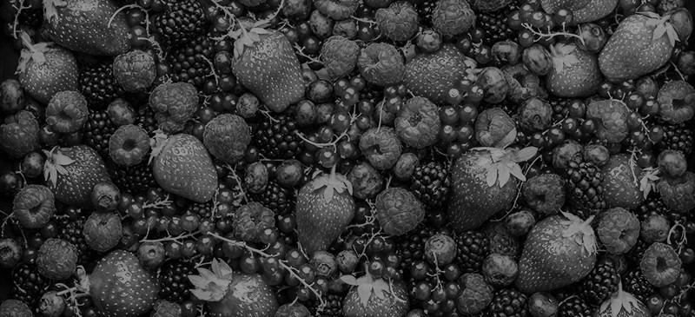
Fruit Recognition
Joel Yuhas

Slide 2
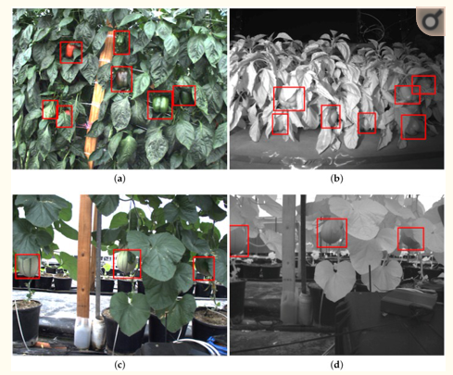
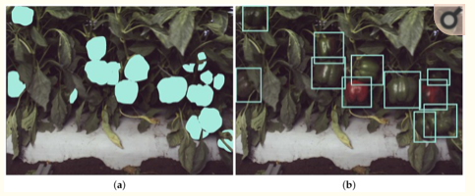
Related Work - DeepFruits
“Fruit Detection System using deep neural networks”
Created for autonomous agricultural robotic platform
Used Faster Region-based CNN
0.838 accuracy for sweet pepper
RGB and NIR light

Slide 3
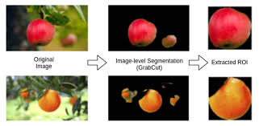
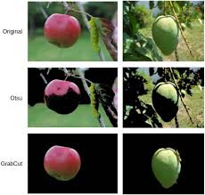
Related Work – Automatic Fruit Recognition
Used color and texture features to recognize fruits
Texture features from Gray-level Co-occurrence Matrix (GLCM)
Support Vector Machine (SVM) Classification model

Slide 4
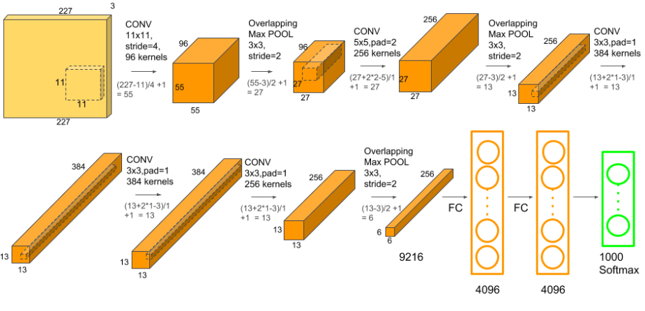
Methods
AlexNet was the CNN used
Started with default parameters
Learning rate 0.001 *decreased by 0.1 factor every 7 epochs
Momentum 0.9
5 convolutional layers
Followed by max-pooling layers
Last 3 fully connected layers
Only modified last layer to match class outputs
Pre-Trained

Slide 5
Methods
Started with 10 classes, went up afterwards
Images had to be scaled to 255 x 255
Learning rate and magnitude changed as testing went on
Batch size and layer configuration did not
Transfer learning technique from homework 5 was employed as main foundation of the project

Slide 6


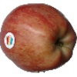
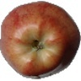
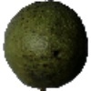
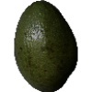
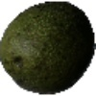
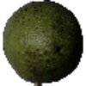




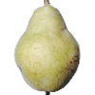
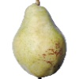
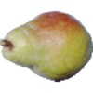
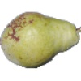
Experimental Methods – Datasets Fruits 360
Fruits 360 Dataset
69905 images
~ 62,000 training images
~ 7,000 test images
101 Different classes
Very clean images

Slide 7
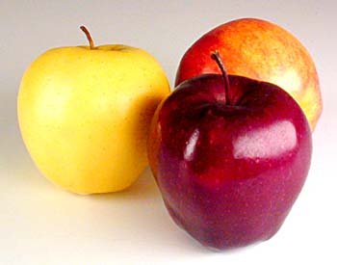
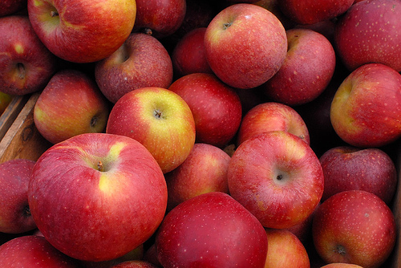
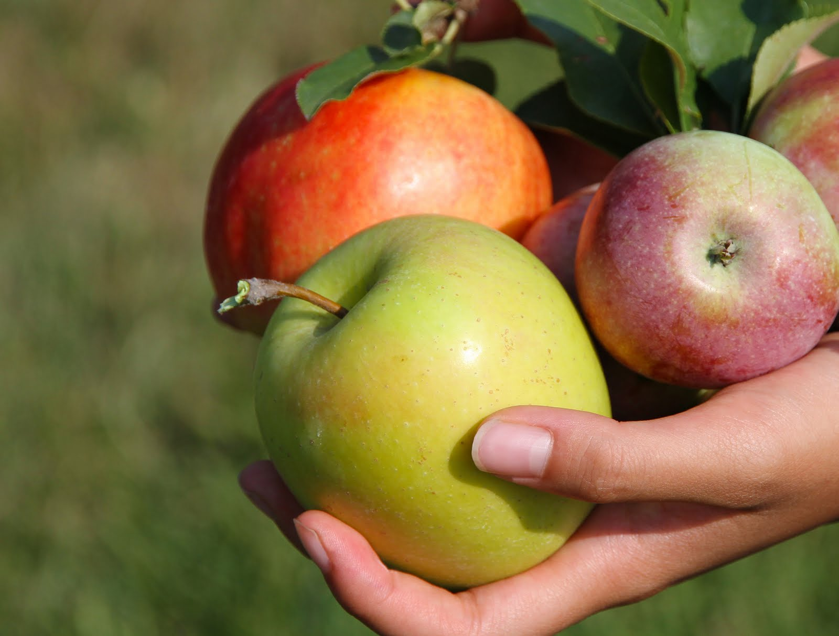
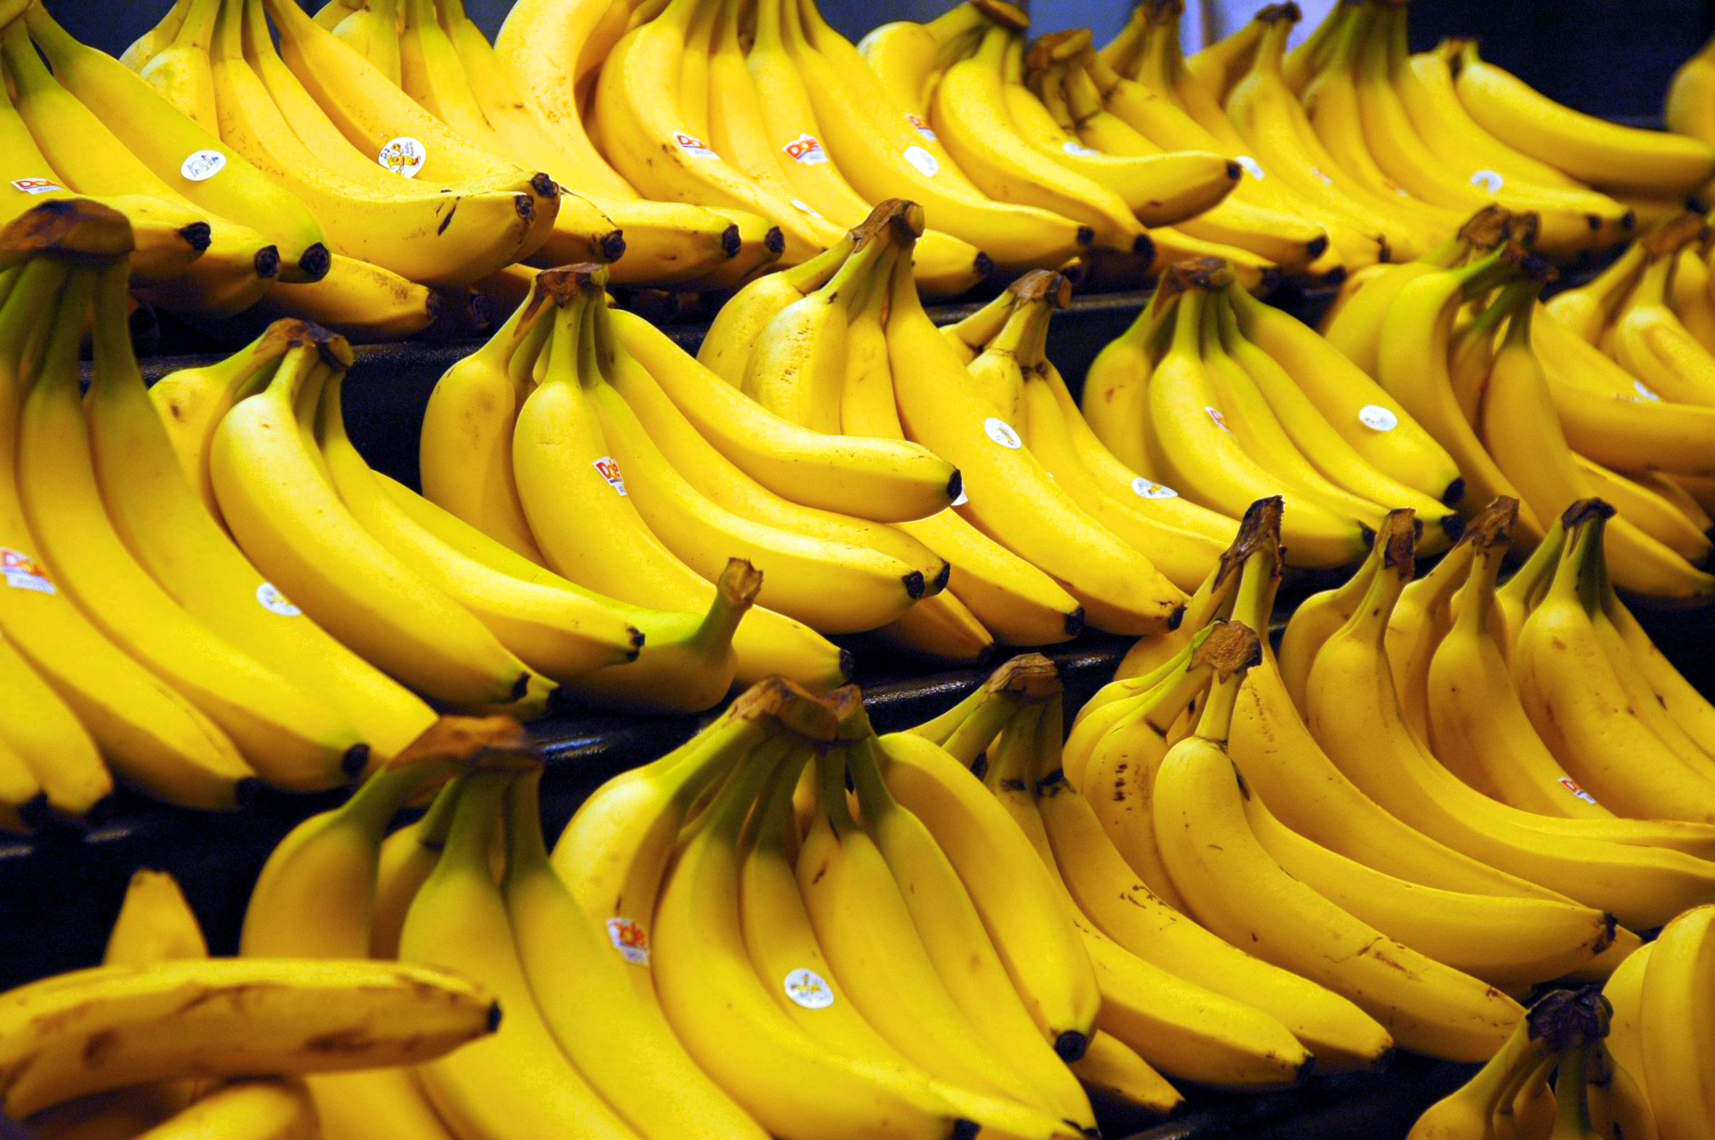
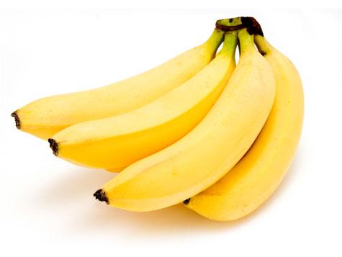
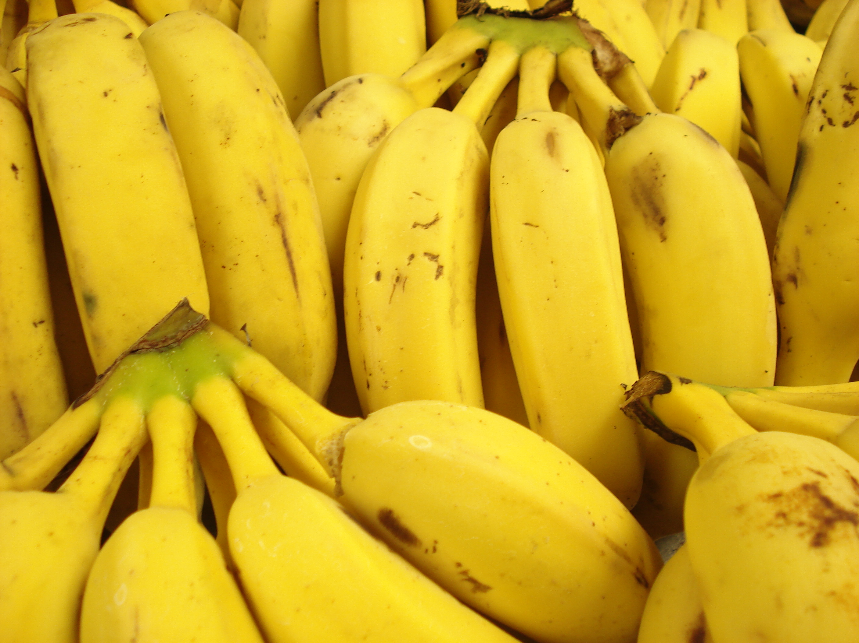
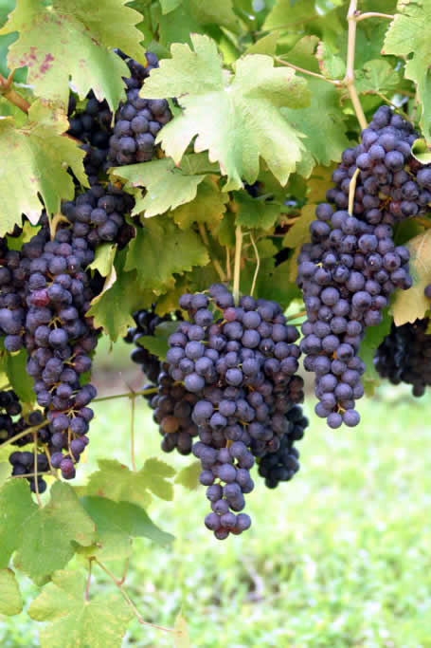
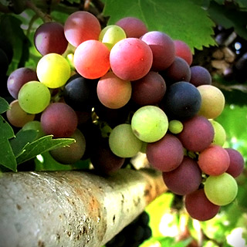
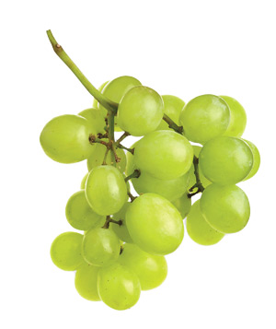
Experimental Methods – Datasets FIDS30
FIDS30 data set
Around 1500 images
30 different classes
Images had much greater variety and was closer to real world situations
Fruit “in the wild”
Images ranged in size
~ 50 training images
~ 8 test *

Slide 8
Experimental Methods – Protocol
Test data with default parameters
Adjust the learning rate and momentum per results
Test 10 classes minimum, if good results increase classes
Goal:
> 95% dataset 1
> 75% dataset 2

Slide 9
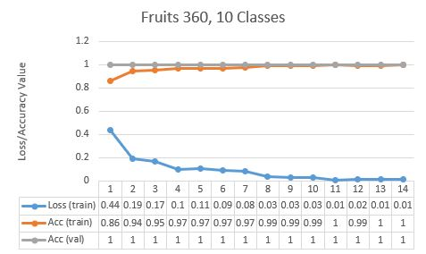
Results – Fruits 360 Dataset
Test with 10 classes had 99.99% training accuracy and 100% test accuracy with no changes
Deemed too easy, so increased number of classes to 101

Slide 10
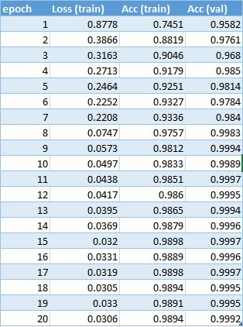
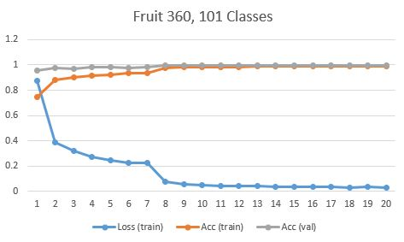
Results – Dataset 1
Training accuracy of 98.94%, test accuracy of 99.92%
Took 3+ hours to train

Slide 11
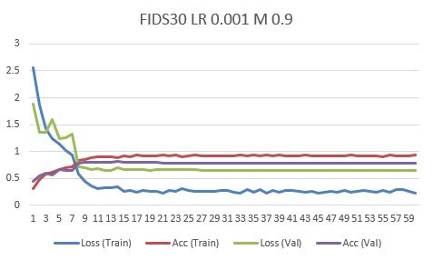
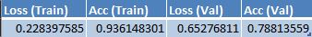
Results – FIDS30 Dataset 2
Used full 30 classes
Changed LR and M
Ran with default parameters first
Ran with 60 epochs each

Slide 12
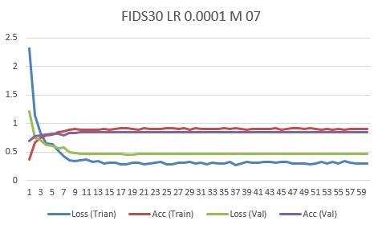
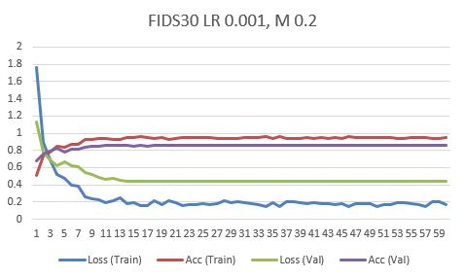
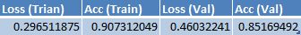
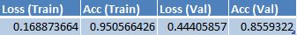
Results – Dataset 2
Train accuracy above 95%
Test accuracy above 85%

Slide 13
Critical Evaluation
In both cases, AlexNet was able to get above goal accuracy
Both data sets worked out extremely well
However, large dataset took considerably longer to train
Did not have to make many changes to get better accuracy
Compared to other works, did not have to do segmentation portion

Slide 14
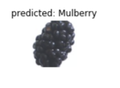
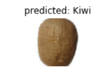
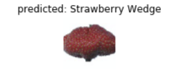
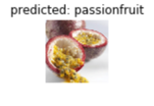
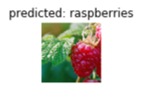
Conclusion
Overall, project was very successful
Exceeded all goals
Results were very accurate and reliable
Similar to other real world projects, but a bit more simplified

Slide 15
